Slide 1
Java Secure Coding
Yifan Liu

Slide 2
Java Security Infrastructure
PKI & SSL
Authentication & Access Control
JAAS
Crypto Providers and Algorithms
JCA/JCE
Java Language Specification
(JVM)

Slide 3
Crypto Providers and Algorithms
 | Hashing | Encryption
Purpose | Ensuring Integrity | Keep Secret
Consistent Output | Yes | No
Reversible | No | Yes
Has Key | No | Yes
Various Input | Absolutely different result | Same result acceptable

Slide 4
List all security providers
download groovy:
http://www.groovy-lang.org/download.html
SecProviders.java

Slide 5
Encrypt the message when
It’s not allowed to be seen by any people other than the recipient(s)
EnDecrypt.java

Slide 6
Hash the message when
It is not allowed to be modified by anybody.
But it’s allowed to be seen by others.
SHA256.java

Slide 7
Asymmetric Encryption
Keys exist in pairs
Keep one private (very secret) and 'publish' one
Public keys can exist on certificates
Encryption can be done by either key
If it is your key pair, you can use the private key
Anyone else can use the public key to encrypt something

Slide 8
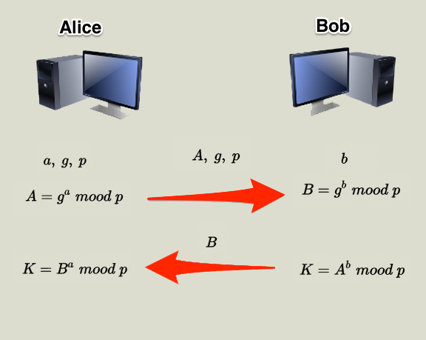
Asymmetric Encryption

Slide 9
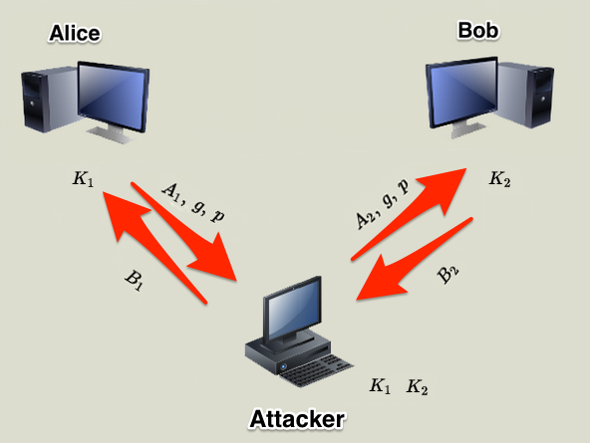
Public Key Infrastructure

Slide 10
Public Key Infrastructure
Public Key
Private Key

Slide 11
Private keys
Extremely secret!
If you send something encrypted by a private key, it can be read by everyone, but they know it came from you.
Authentication

Slide 12
Public keys
Not at all secret!
Widely available, but must be trusted
May be supplied as part of a certificate
If you send something using a public key, it can only be read by the entity to which it is addressed.
Secure communications
(But secure communications (e.g. SSL) isn’t quite as simple as that!)

Slide 13
How can I trust a public key?
Someone can use a public key to prove their identity to me
but only if I trust that public key
there's public keys out there that say they belong to Bob etc.
So if someone I trusted endorsed (signed) that public key
hold that thought for a moment...

Slide 14
Signing things with keys
Keys can be used to sign things
encrypt a bit of text with your private key (can be attached 'securely' to the 'document')
people can de-crypt it with the public key and know that it was signed by you

Slide 15
Coding Practices
Java keystore
-- KSTest.java
Generate key pair
Sign and Verify
--KeyPairSign.java

Slide 16
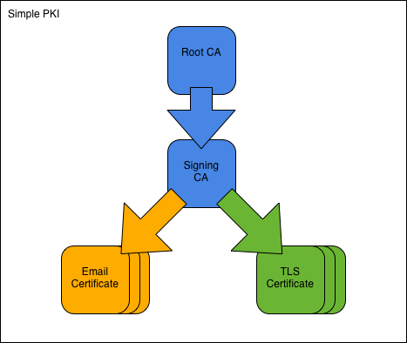
Certificate Authority

Slide 17
Certificates and SSL
self sign ca cert:
openssl req -x509 -newkey rsa:2048 -keyout key.pem -out cert.pem -days 3650
generate req:
openssl req -newkey rsa:2048 -keyout my.key -out my.pem -config openssl.cnf

Slide 18
Certificates and SSL
sign req:
openssl ca -config openssl.cnf -in my.pem -out my.crt
export into p12
openssl pkcs12 -export -in my.crt -inkey my.key -chain -CAfile .\demoCA\cacert.pem -out my.p12

